Slide 1
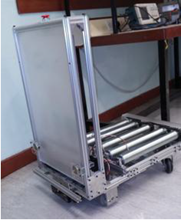
AGV motion control system
Name | Position
Lang Yujian | Hardware engineer
Guo Zichang | Hardware engineer
Gu Tiantu | Software engineer
Liu Haikun | Software engineer

Slide 2
Introduction
An automated guided vehicle or automatic guided vehicle (AGV) is a mobile robot that follows markers or wires in the floor, or uses vision, magnets, or lasers for navigation. They are most often used in industrial applications to move materials around a manufacturing facility or a warehouse. Application of the automatic guided vehicle has broadened during the late 20th century.

Slide 3
Objective
Develop the motion function for the AGV main controller
Design and fabricate the motor drivers and sensors interfacing circuit
Implement the speed control and AGV steering algorithm

Slide 4
Key features
Automatic robust speed control
Remote control
LEDs direction indication

Slide 5
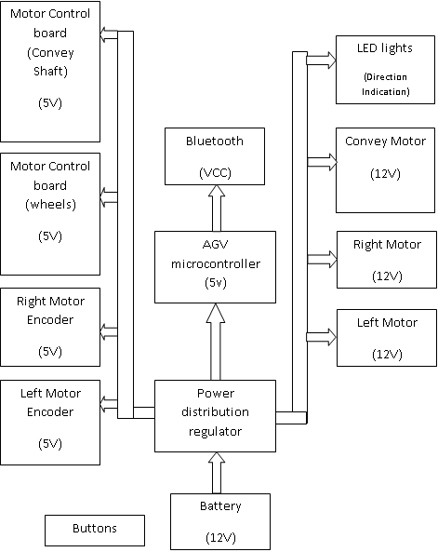
Block Diagram

Slide 6
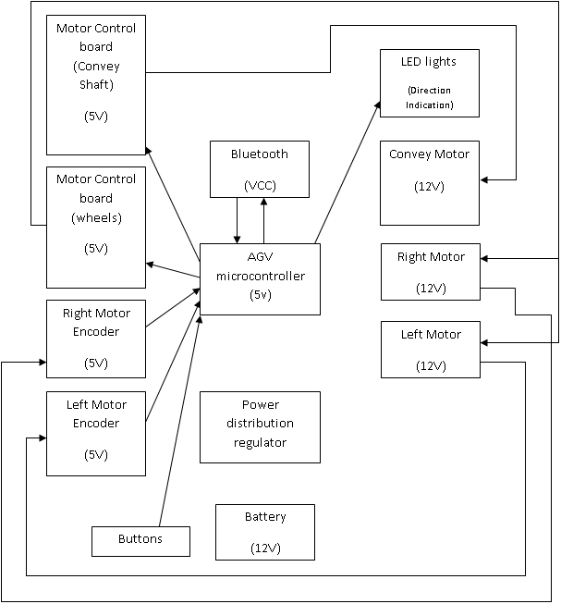
Block Diagram

Slide 7
Market research
The AGVS market has ranged from $40-100 million per year over the last 10 years. This generally represents 30-80 systems. The average system has about 4-5 vehicles. The largest material handling AGV systems have 50-100 vehicles. There are numerous small systems with 1-3 AGVs. For a functional AGV system, the average sale price ranges from 10,000 RMB to 35,000 RMB.

Slide 8
Cost analysis
Components | Quantity | Unit Price | Total Prices
OMRON Encoder (E6B2) | 2 | 180 | 360
DC Motor (4GN-18K) | 3 | 220 | 660
Bluetooth Module | 1 | 30 | 30
Motor Drive | 2 | 100 | 200
IC (SDK-NUC140VE3CI) | 1 | 25 | 25
Other Components (resistors, capacitors…) |  |  | 50
Development Tools | 1 | 30 | 30
Total |  |  | 1355

Slide 9
Project process
Week 1: focus on programming, circuit design
Week 2: focus on PADS drawing, PCB layout and fabrication of PCB
Week 3: focus on trouble shooting and program debugging
Week 4: report, presentation and the web page will be finished within this week

Slide 10
Key Components & Tools
Key Components:
  NuTiny-SDK-NUC140
  Bluetooth module
  Motor Drive control board
  Power control
Tools:
  PADS Logic
  PADS Layout
  PCB Fabrication Machines
  Oscilloscope
  Multi-meter
  Circuit Tester
  Soldering Iron

Slide 11
Q & A

